Slide 1
Microstrip Antennas
Luke Chapman

Slide 2
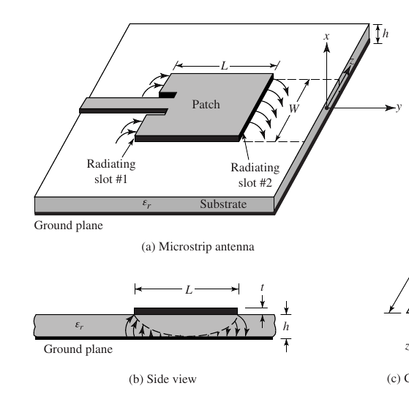
What is a Microstrip Antenna?
Patch antennas consist of a thin metallic strip above a ground plane separated by a dielectric substrate
Microstrip (patch) antennas are used extensively in applications where physical dimensions are limited
Radiation is caused by an electric field induced between the patch and the ground plane
The primary direction of radiation is normal to the plane of the patch

Slide 3
What is a Microstrip Antenna?
Pros:
High Gain
Easy Fabrication
Low Cost
Cons:
Narrow Bandwidth
Restricted to Low Power Applications
Typically lower efficiency than other antennas
Only practical at higher frequencies (>1 GHz)
Applications:
GPS Antennas
Satellite Communication
High-Frequency Communication
Mobile Communication

Slide 4
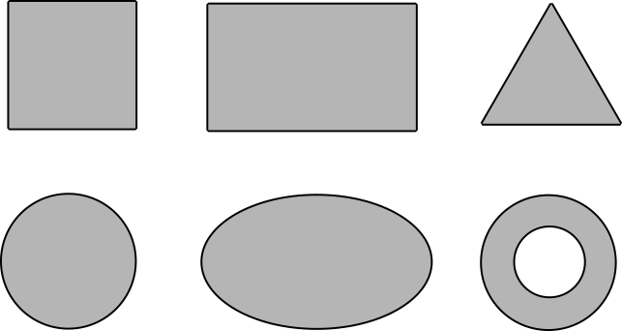
Types of Patch Antennas
Common patch antenna shapes include rectangle, square, equilateral triangle, circle, ellipse, and ring
Rectangle and square are the most common shapes

Slide 5
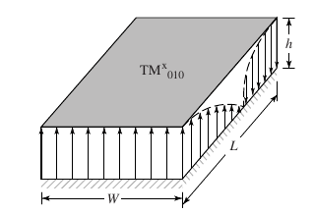
How Patch Antennas Work
The simplest model of a patch antenna is as a transmission line
By feeding the antenna at some frequency, there will be current distributions on the patch and ground plane and a voltage distribution between
Given an input wave, some energy will be reflected back, causing standing waves
This causes the current and voltage distributions

Slide 6
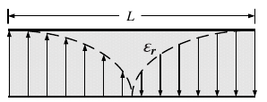
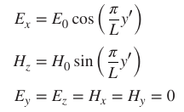
Patch Antenna Radiation Mechanism
If the dimensions are suitable at a given frequency, the patch antenna will resonate as an open-circuited transmission line
The voltage and current are out of phase
The voltage is maximum at the edges, the current is maximum in the center
The TM010 distribution is the most commonly used
Will result in linear polarization along the L-axis
In this ideal model, the antenna does not radiate

Slide 7
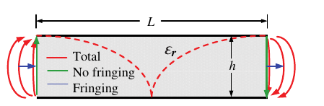
Patch Antenna Radiation Mechanism
For radiation to occur, the voltage must be at a maximum at the edges
Fringe fields will be induced at the edges of the patch antenna
The horizontal components of the fringes (blue) are in phase and in the same direction and add up
These electric fields superimpose and provide the primary method of radiation of the antenna

Slide 8
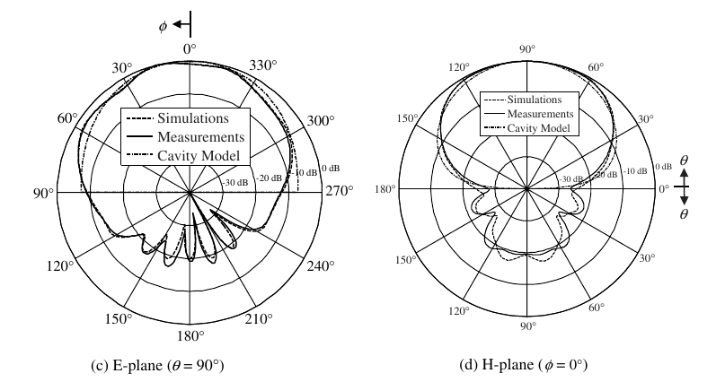
Radiation Patterns
Patch antennas display high gain in the broadside direction of the patch
Side and rear lobes are present, but can be improved by using different feeding techniques
Patch antennas are also easy to make into arrays, improving the main lobe gain substantially

Slide 9
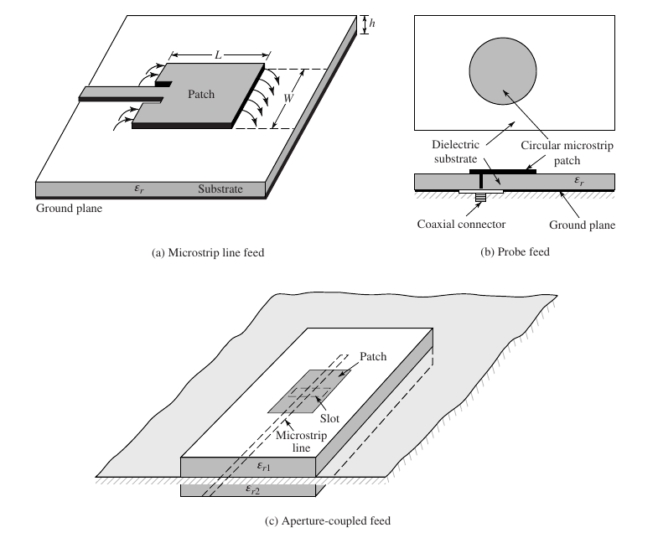
Methods of Feeding Patch Antennas
Feeding method of the patch antenna is extremely important
Various feed methods provide better bandwidth, spurious radiation, etc.
Coplanar Microstrip Feed (left)
Antenna fed by microstrip line
Most common
Requires impedance matching
Coaxial Feed (right)
Inner conductor of coaxial connector passed up through the substrate to the patch
Simple to implement, but with thicker substrates causes large amounts of spurious radiation

Slide 10
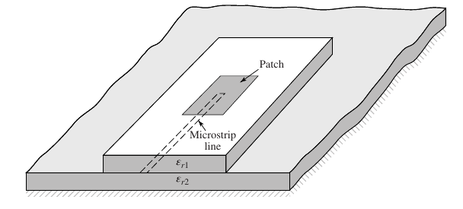
Methods of Feeding Patch Antennas
Proximity Coupling Fed (Top)
A feedline is fed between the ground plane and patch inside of the substrate, which couples to the patch
This method provides low spurious radiation and higher bandwidth
Aperture Fed (Bottom)
The feedline is placed on the bottom of the substrate
A ground plane with a slot aperture is placed between the patch and the feed line
This shields the patch from the radiation from the end of the feedline
Provides high bandwidth and polarization purity

Slide 11
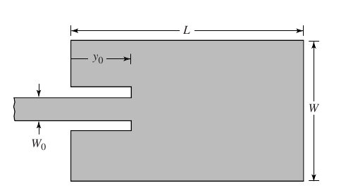
Impedance Matching
Typically the input impedance of the patch antenna will be very high and not matched to the feedline (typically 50 Ohms)
Several methods to impedance match
Matching circuit
Stub matching
Inset Feedline
The inset feedline is one of the most popular techniques
Because the effective resistance at a point on the patch antenna is determined by the characteristics of voltage and current

Slide 12

Impedance Matching
Because the patch is high-impedance at the edge (high voltage, zero current), it will be poorly matched to a 50 Ohm feedline
By moving the feedline connection to a different position on the patch antenna, resistance will be different
By choosing the correct inset distance, the patch input impedance can be matched to the impedance of the feedline

Slide 13
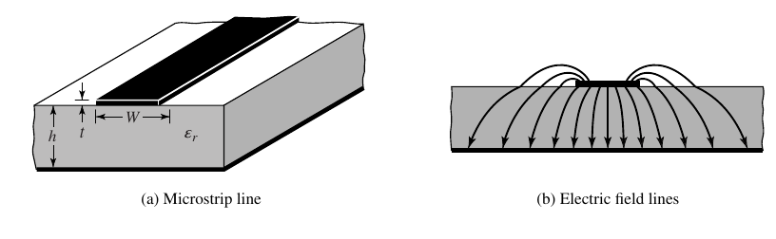

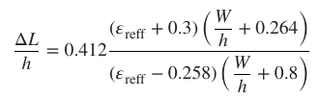


Designing Patch Antennas
The process for designing a patch antenna is fairly straightforward
The target frequency and dielectric constant should be known
Because of the difference in dielectric constants, the patch “looks” larger than it actually is and must be corrected
The formulas to calculate the width and length of the patch antenna are shown on the right

Slide 14
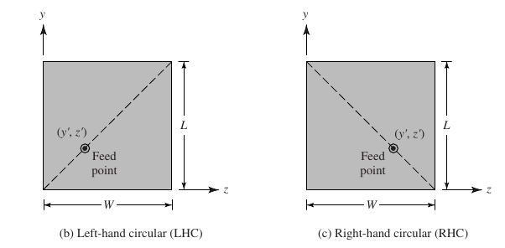
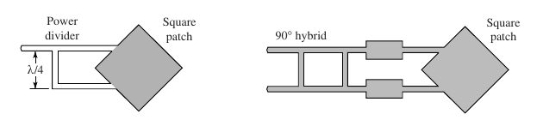
Circular Polarization
Circular polarization is often advantageous, especially when a received signal is of an unknown polarization
Circular polarization can be done in several different ways
Array of linear polarized patch antennas with perpendicular polarizations excited in quadrature
Single patch antenna that has two perpendicular modes excited with a 90-degree phase difference

Slide 15
References
[1] R. Garg, Microstrip Antenna Design Handbook. Boston, MA: Artech House, 2001.
[2] C. A. Balanis, Antenna Theory Analysis and Design. Hoboken, NJ: Wiley, 2016.
[3] D. R. Jackson, “Introduction to microstrip Antennas,” University of Houston, https://courses.egr.uh.edu/ECE/ECE6345/Short Course/Introduction to Microstrip Antennas.pdf (accessed Mar. 1, 2024).

